Slide 1



THE UNIVERSITY OF ARIZONA
HISPANIC ALUMNI CLUB
Portraits of Excellence
CROWNING EXCELLENCE
A Mardi Gras Soirée
SATURDAY, MARCH 1, 2025
El Conquistador Tucson Resort
10000 N Oracle Rd, Tucson, AZ
6:00pm - 12:00am

Slide 2
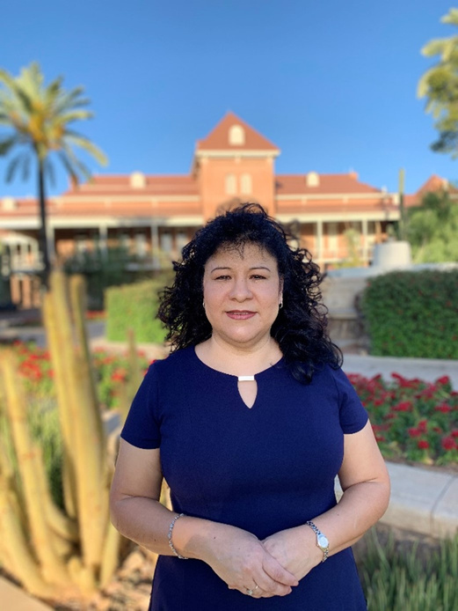

Welcome y Bienvenidos
To the University of Arizona Hispanic Alumni (UAHA) Portraits of Excellence Crowning Excellence:
A Mardi Gras Soirée!
It is with great enthusiasm and gratitude that we honor both Czarina Lopez and Dominic Ortega this evening. They were selected for their significant contributions to our community. More importantly, these two individuals are people of great character and heart. I feel both honored and privileged to be able to recognize them as this year’s honorees!
Founded in 1982 by a group of Hispanic students, UAHA remains dedicated to promoting academic excellence, providing scholarships, and fostering alumni connections. Through our partnership with the Adalberto & Ana Guerrero Student Center and the UA Thrive Center, we support our scholars with mentorship and programming to help them thrive!
According to an analysis by the UA Hispanic Serving Institution Initiatives, since 2016, UAHA Scholars have maintained a retention rate of 92% or higher—consistently exceeding the UA average for main campus, first-time students. Additionally, in the 2022-2023 academic year, they had a 95% retention rate, a six-percentage-point increase compared to a matched peer group. This cohort of UAHA Scholars also had higher term and cumulative GPAs than their matched peers. We have proven that investing in our scholars is a sound investment.
As I write this welcome, it is with great pride that I share that this is a record-breaking year for both the number of scholarships awarded and the total dollar amount! For the 2024-25 academic year, we have awarded 201 scholarships totaling $1,061,704! This monumental feat was made possible thanks to a large donation, twelve named scholarships, 90 University of Arizona Tuition Waivers, and the scholarship endowment at $1.8 million. Our UAHA scholarships are open to all UA students who meet the criteria for each scholarship. Our goal was to reach the $2 million mark with our endowment, and I am thrilled to announce that thanks to this dinner, your incredible generosity, and the unwavering fundraising leadership of Mr. Humberto Lopez, along with the support of Czarina and Dominic, we have not only reached but surpassed our GOAL! — ¡Muchísimas Gracias!
In closing, as we reflect on the incredible contributions and impact our honorees have made, I challenge each of you to go out and be a Czarina or Dominic in someone’s life—go out and make a difference! I extend my heartfelt gratitude to the amazing UAHA Board, as well as to all of you for your invaluable support and dedication to the University of Arizona Hispanic Alumni Club. We look forward to continuing this journey together and building a brighter future for our community.
Agradecidamente,
Letty Molina-Gutierrez, M.Ed.
Board President
The University of Arizona Hispanic Alumni
As you reach up, reach down and pull someone up with you.
-Joel Valdez

Slide 3

Portraits of Excellence
CROWNING EXCELLENCE
Event Schedule
CHECK-IN
Cocktail Hour, Raffle Entries, Photo Booth & Photos with Wilbur and Wilma Wildcat
Lupita Murillo, Retired Investigative Reporter, KVOA News 4
Mistress of Ceremonies
Welcome
Letty Molina-Gutierrez, UAHA Board President
Land Acknowledgement
Jonathan Rios, American Indian Alumni President
DINNER
AWARD PRESENTATION
Honoree Recognition
Czarina Lopez & Dominic Ortega
UAHA LEGACY
Violeta M. Ramos, Governing Board President, Osborn School District
Raffle winners
Closing y Gracias!
MUSIC BY DJ KARMUH
2025 Portraits of Excellence Planning Committee:
Letty Molina-Gutierrez, Celina Urquidez, Ramon Gutierrez, Ray Haro,
Anaid Moreno, Emilio Romero, Marga Gamas, Estephania Herrera

Slide 4
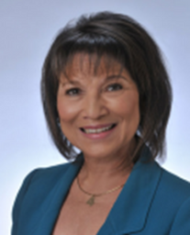

Mistress of Ceremonies
Lupita Murillo
Lupita Murillo enjoyed an extraordinary 50-year career as a broadcast journalist, where she fearlessly reported on everything from drug tunnels and wildfires to witnessing executions and chasing down child molesters. Her dedication to delivering impactful stories earned her widespread respect and admiration.
Beyond her remarkable career, Lupita has been a steadfast supporter of her community. In retirement, she continues to dedicate her time and energy to causes close to her heart, volunteering with organizations such as the Alzheimer’s Association, TIHAN, and the Boys and Girls Club.
Throughout her career, Lupita received numerous accolades, including several Edward R. Murrow Awards, Associated Press Awards, and recognition from American Women in Radio and Television. She was also inducted into the prestigious Rocky Mountain Emmy Silver Circle, which honors media professionals with 25 or more years of distinguished service in the television industry. Additionally, she is a proud recipient of the University of Arizona’s Portrait of Excellence Award.
Lupita is married to Don Gutzler, a former educator and gymnastics coach who trained two Olympians, Kurt Thomas and Kerri Strug. Together, they share a life dedicated to excellence, service, and inspiring others.
Land Acknowledgement
We respectfully acknowledge the University of Arizona is on the land and territories of Indigenous peoples. Today, Arizona is home to 22 federally recognized tribes, with Tucson being home to the O’odham and the Yaqui. Committed to diversity and inclusion, the University strives to build sustainable relationships with sovereign Native Nations and Indigenous communities through education offerings, partnerships, and community service.

Slide 5










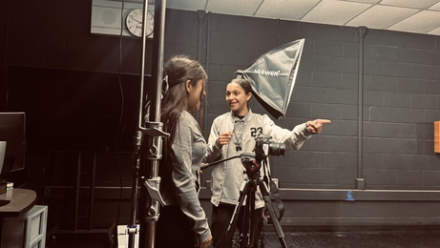


Raffle Sponsors
Special Thanks
to the students enrolled in the PBS News Hour Student Reporting Lab at Utterback Middle School, under the direction of Nancy Montoya, for their exceptional work on the Portraits of Excellence honoree videos.
With more than 45 years of experience in major market and network newsrooms, Nancy has held roles as a reporter and producer at stations including KDKA (Pittsburgh), KDFW (Dallas), KUSA (Denver), WSOC (Charlotte), WSMV (Nashville), and in Tucson at KGUN-TV, KOLD-TV, and KVOA-TV.
Nancy’s work has earned her six Emmy Awards, a Peabody Award, and several other international broadcast honors. She and her husband, fellow producer Kirt Ijams, share two sons and co-own Media Source America, which produces independent documentary projects.
Learn more about the works of Nancy Montoya

Slide 6



Slide 7
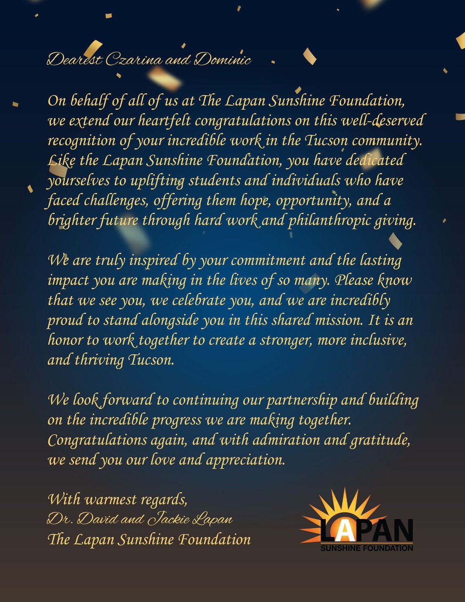

Slide 8


Thank You
To Our
Photo Booth Sponsor!

Slide 9










Thank You to Our Gato Bronze Sponsors
William Chappelow
David & Ellen Goldstein
Diamond Foundation
Robert & Beverely Elliott
Humberto Stevens
The Gootter-Messing Families
Leanna Trujillo

Slide 10



Thank You to Our Gato Silver Sponsors
Ginny L. Clements
Thank You to Our Gato Gold Sponsors
Bridget Canel Ash
Frank Dworski
Jordy Ensio
Dale Lillard

Slide 11



Thank You to Our Gato Platinum Sponsors
BWL Investments
Paul & Alice Baker
Thomas R. Brown Foundation
Jim Click
Coit Family Foundation
Steve Hilton
Jim Horvath
Carlos & Esther Michan
Robert Sarver
Glenn Toyoshima
Thank You to Our
VIP Gato Sponsor

Slide 12

Thank You to our
Gato Donors
John Cox
Randy Dix
David Frosh
Dean Greenberg
Steve Knappenberger
Arnold Kraus
Ben and Sally Perks
Dr. Lori Mackstaller
Doug Martin
Stephen McConneell
Tom and Caren Newman
Joey Rodolfo
Lisa Rosenfeld
Joe Sicari
Mike Watts

Slide 13


Slide 14

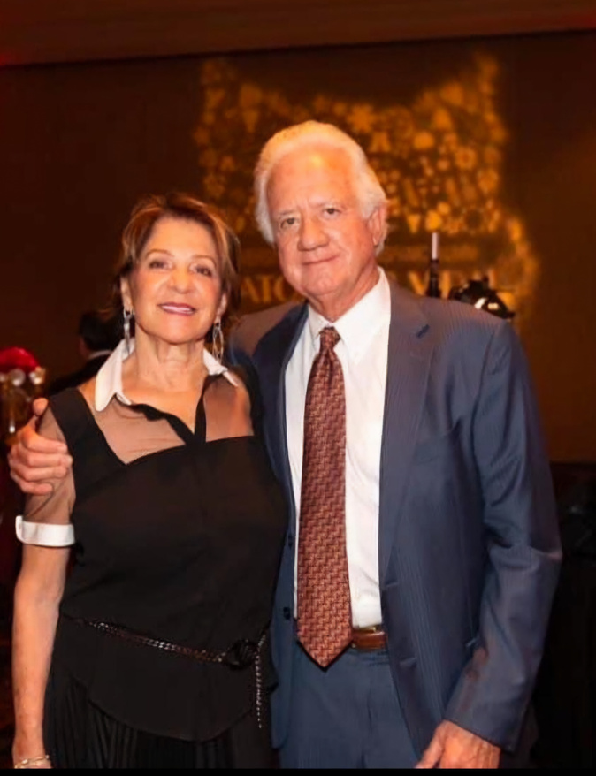
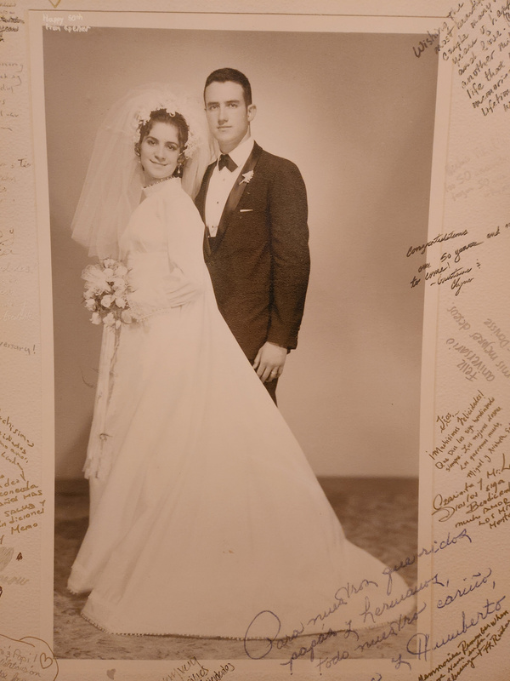
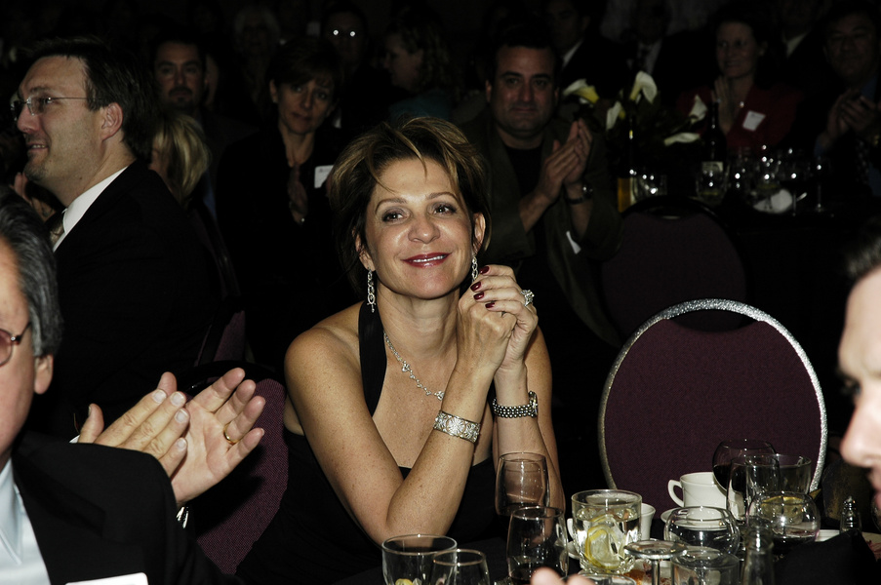
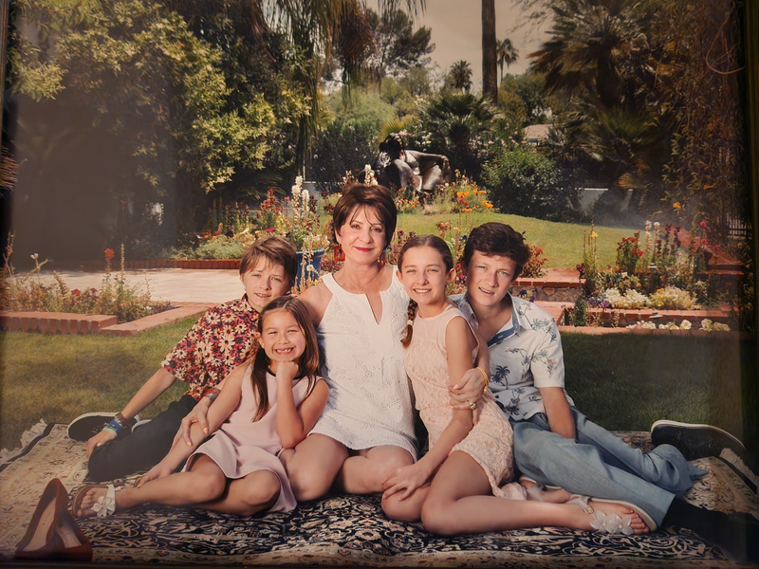
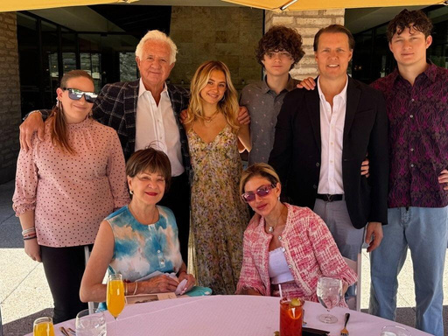
Czarina Lopez

Slide 15
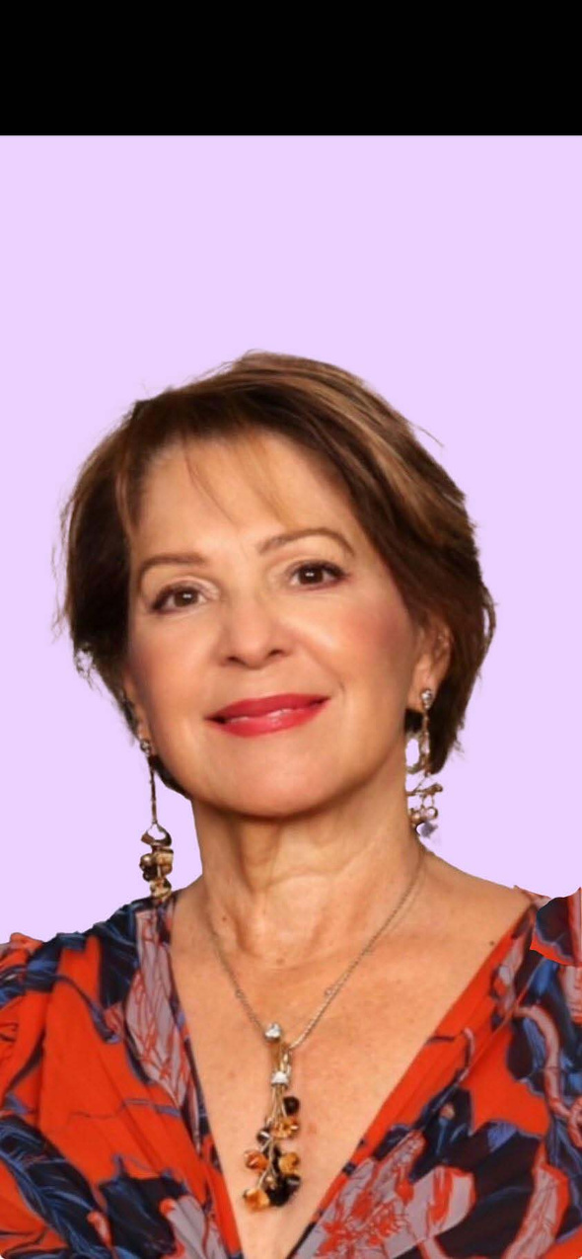
2025 Portraits of Excellence Honoree
Czarina M. Lopez
“It grows on you. The more you give, the more you notice it’s not enough”
Czarina M. Lopez is a dedicated philanthropist and community leader who has made an indelible impact on Southern Arizona through her tireless commitment to charitable giving and civic engagement. Alongside her husband, Humberto S. Lopez, Czarina was honored as the City of Hope Couple of the Year, a testament to their shared dedication to uplifting others.
Over the years, Czarina has become instrumental in advancing numerous Tucson-based causes. Her past involvements include serving esteemed organizations such as Tucson/Mexico Sister Cities, Tucson Museum of Art League, Open Inn, Angel Charity for Children, La Frontera Center, Steele Memorial Children’s Research Center, Las Familias, Friends of the Cancer Center, Parseghian Medical Research Foundation, Salpointe Catholic High School, and St. Cyril’s Foundation. Her unwavering support also extends to the Center for Integrated Medicine.
Czarina's leadership extends beyond volunteerism to governance, having served on the boards of San Miguel High School, Tu Nidito, Catholic Community Services, and the Catholic Community Services Foundation. Through these roles, she has contributed her time, energy, and expertise to supporting impactful initiatives that benefit children, families, and individuals in need.
As a philanthropist, Czarina believes that true giving goes beyond financial contributions, encompassing the gifts of time, compassion, and knowledge. She and her husband founded The H.S. Lopez Family Foundation, an organization that focuses on advancing education, health, and welfare in our community. Under their leadership, the foundation has transformed lives through its commitment to fostering opportunities for underserved populations.
One of the Lopez family's proudest accomplishments is the establishment of the Center of Opportunity, a facility that offers comprehensive services to individuals experiencing homelessness. Guided by dignity and respect, the center empowers its clients to transition out of homelessness and work toward self-sufficiency, reflecting Czarina's deep belief in the transformative power of hope and support.
Czarina M. Lopez’s enduring legacy lies in her family and her unwavering commitment to building a stronger, healthier, and more equitable community for all. She is a proud mother of two - Iliana and Iovanna, grandmother to four grandchildren, and has shared over 50 years of marriage with her husband, Humberto. Her work continues to inspire others to give generously and serve selflessly.

Slide 16
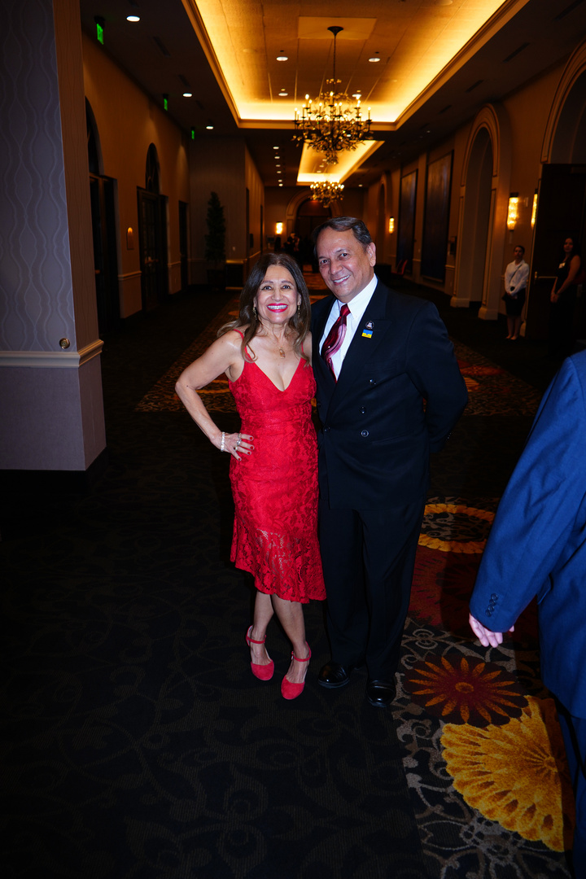
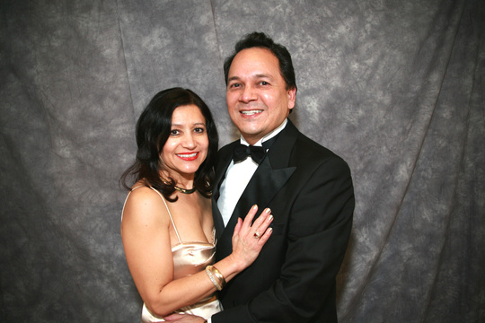
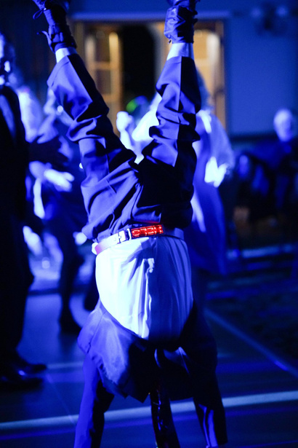
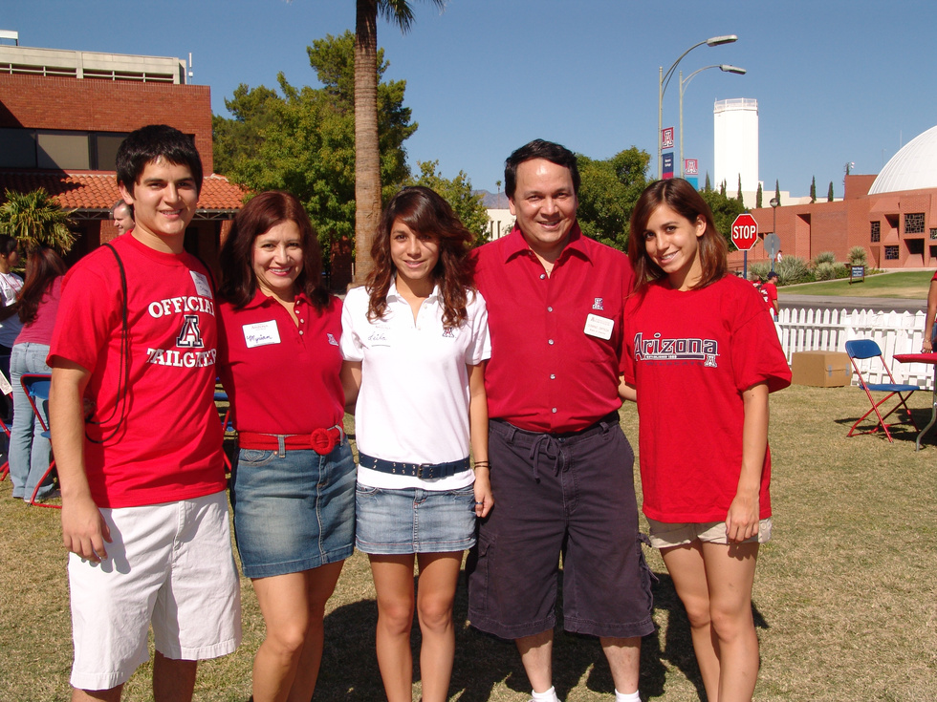
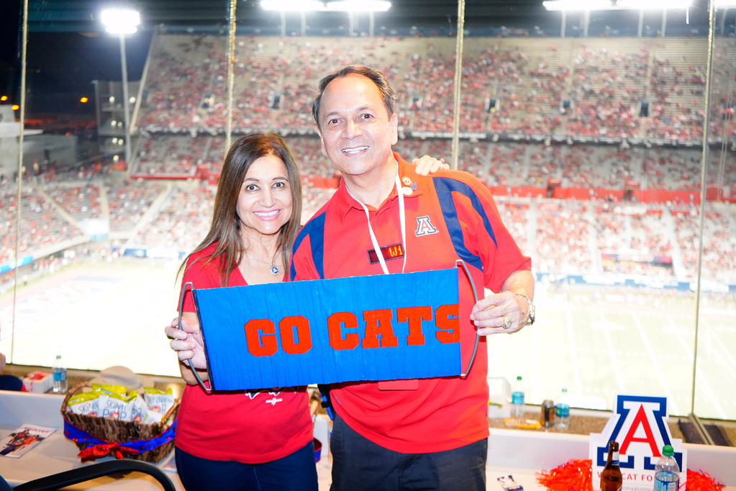
Dominic Ortega

Slide 17
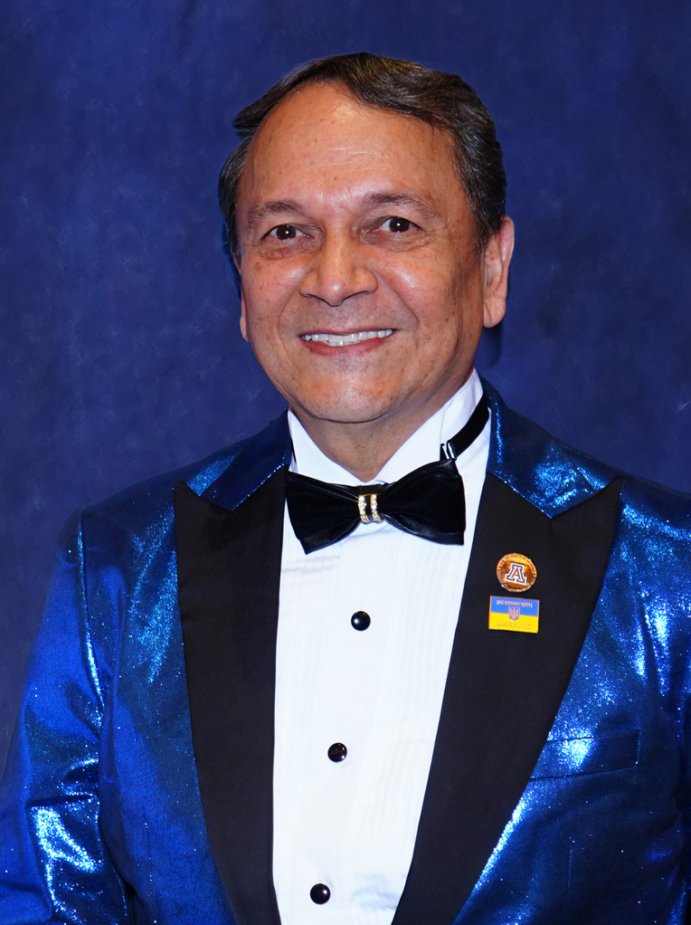
2025 Portraits of Excellence Honoree
Dominic Ortega
“I’m trying to leave this place a little better than I found it.”
Dominic Ortega was raised in Globe, Arizona, as the third of seven children. He drew deep inspiration from his remarkable parents—his father, intelligent and optimistic, and his mother, a self-made success who rose from humble beginnings to become a shining example of strength and grace. Their loving partnership profoundly shaped his outlook on life and relationships.
He attended the University of Arizona, where he earned a degree in Business and met the love of his life, Myriam. They have been married for 45 years and are proud parents to three children: their son, Dominic, and twin daughters, Leila and Raquel. Throughout his successful career, Dominic built his achievements on relationships and integrity, eventually retiring as a Senior Consultant from a $35 billion company. While he garnered recognition through promotions, articles, and television features, his greatest joy came from providing for his family and spending quality time with them.
In retirement, Dominic shifted his focus to supporting non-profits, a passion he discovered during his tenure as President of the UA Hispanic Alumni Club. Under his leadership, the club raised $325,000 for scholarships in a single year. Inspired by this experience, he began dedicating his time to helping organizations share their stories and connect with others who align with their mission.
Attending and supporting over 100 non-profit events annually, Dominic serves as an ambassador, leveraging his corporate expertise to benefit nonprofits and mentor others. His efforts are primarily focused on education, healthcare, and connecting people to meaningful causes.
Dominic’s work has earned him numerous accolades, including being named Philanthropist of the Year in Tucson (2019), receiving the La Estrella Award as a Community Connector (2020), and being honored as Greater Tucson Leadership’s Man of the Year (2023). The GTL Community Impact Award recognized him for his “active support of community projects, demonstrating excellence in leadership, and serving as a source of positive influence and inspiration.” As a proud feminist, he is notably the only man to have received the Women Who Soar Daybreak Award for his steadfast support of women in the community.
He credits his success to his wife, family, and friends. While Dominic may not consider himself wealthy, he feels truly rich in relationships and life. A romantic at heart, he remains deeply in love with Myriam and is committed to leaving the world better than he found it.

Slide 18

Congratulations
on your outstanding achievements! Your hard work and dedication has made a major impact in the Hispanic community. You are an amazing person with a heart of gold.
Well Done Czarina!
Love,
Kim & Scott Sibella

Slide 19
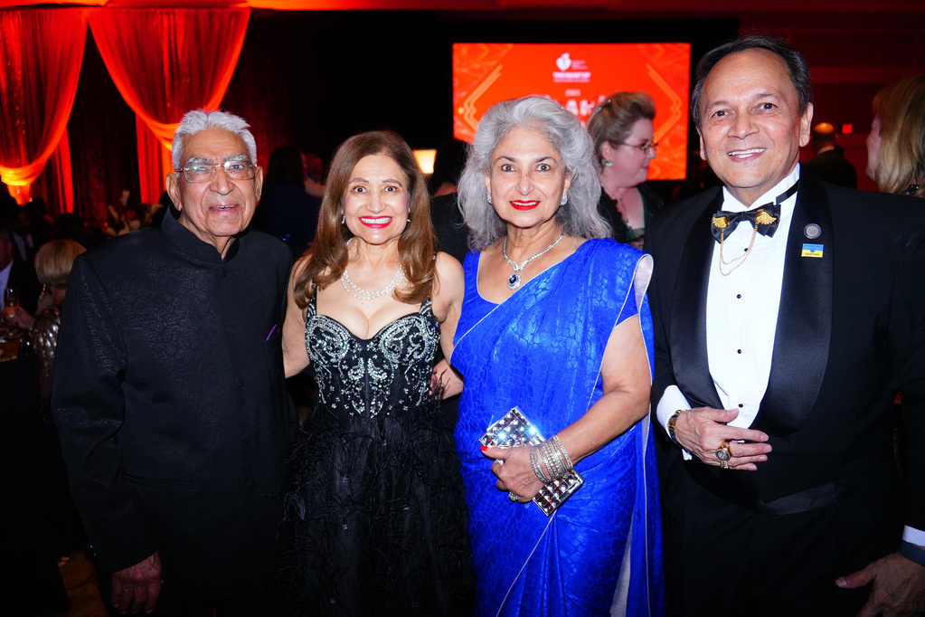
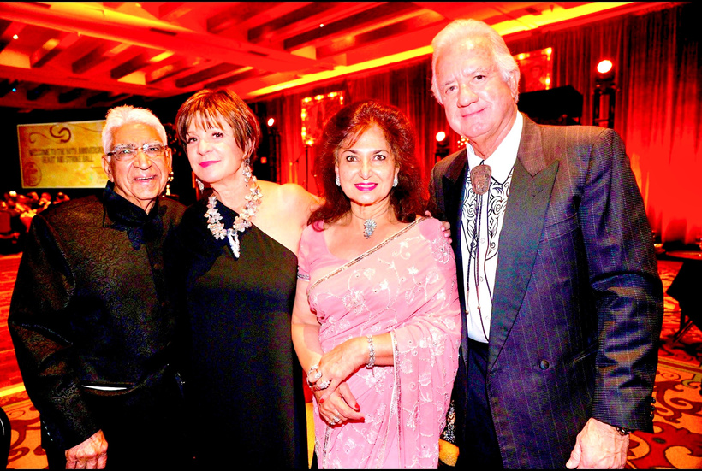
CONGRATULATIONS to TWO of the Most Admired ICONS of Tucson!!!
Czarina Lopez and Dominic Ortega!
We LOVE and ADMIRE Both of YOU soooooo very much ……. as the Dearest of Friends, and for the way Both of YOU give back, and help make our TUCSON such a Beautiful, Kind, and Caring Community! BRAVO!!!
-Gulshan & Neelam Sethi

Slide 20

CONGRATULATIONS
Czarina
We’re proud to celebrate you on this well-deserved honor.
Your dedication and impact are truly inspiring, and we are grateful to witness this special recognition.
Thank you for over 55 years of friendship, filled with laughter, love, and unforgettable memories to last a lifetime.
With admiration and joy,
Marion & Glenn

Slide 21

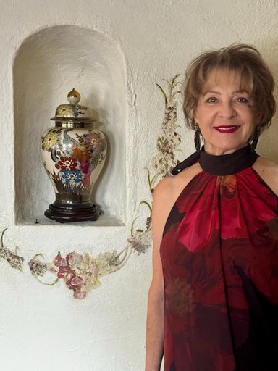
How blessed are we to have you as our friend. All of us wish to thank you for the many gifts you have given to so many organizations in our community.
Congratulations on receiving the 2025 University of Arizona Hispanic Portrait of Excellence Award.
We are so proud of you and love you very much!
-Ginny, Tom, Louise, Lori, Jackie, DeeAnne, Sandy, Gracie, Mike, Judy O.

Slide 22

CONGRATULATIONS
Czarina
A very well deserved recognition.
You are kind, generous, smart, funny, brave and a shining example to all those who know you.
We are proud of our friendship with you.
Love,
Stuart
&
Maureen

Slide 23
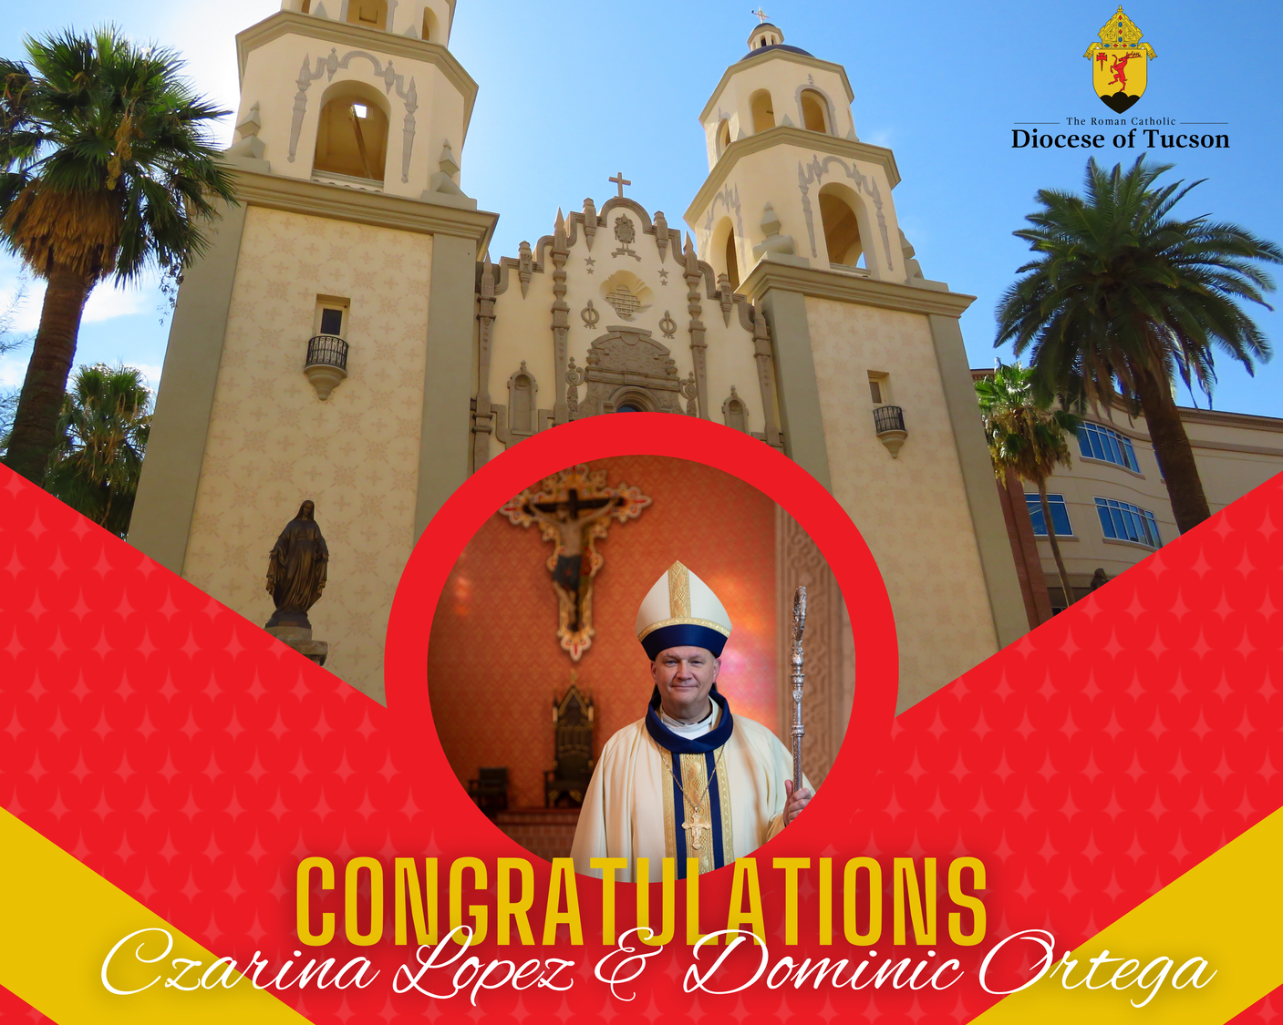


Slide 24
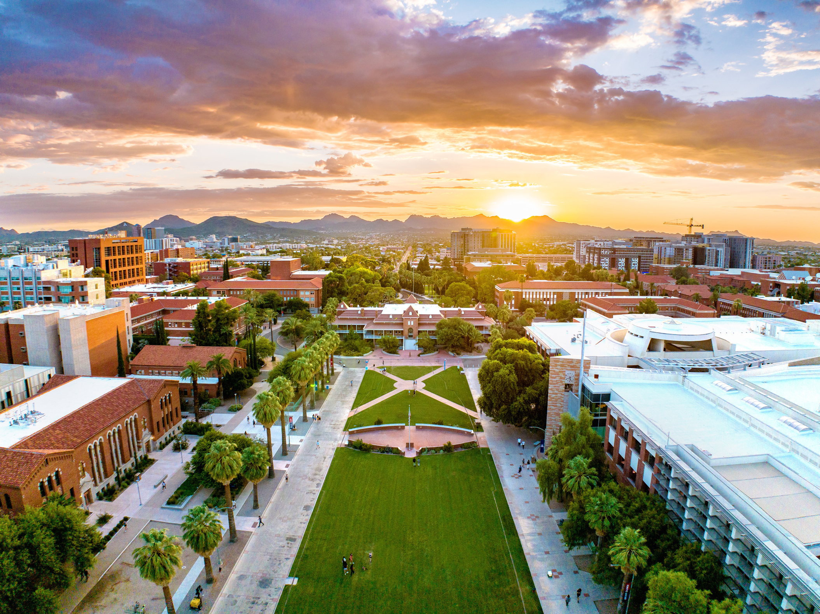
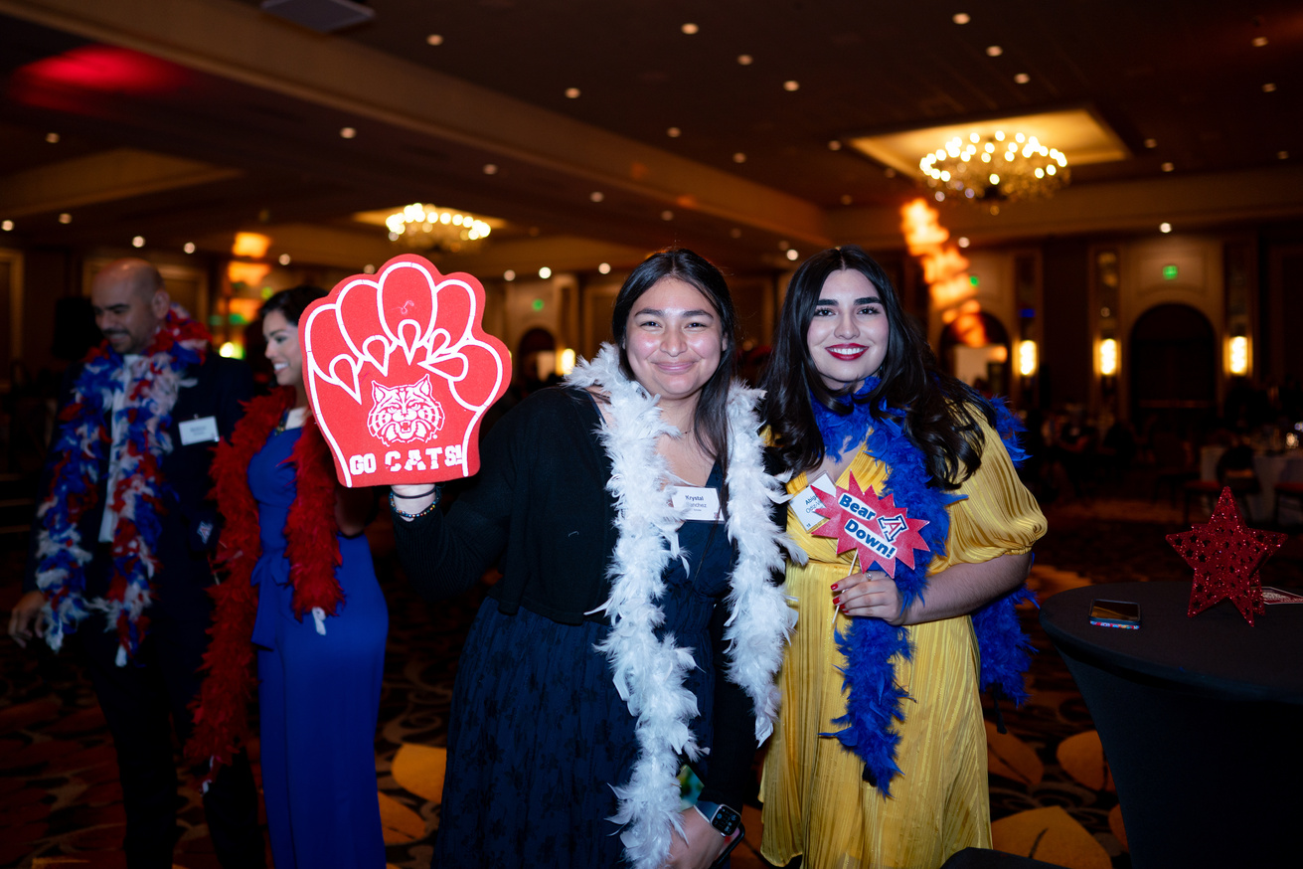
UAHA Scholar Story
UAHA Scholar: Krystal Sanchez
Junior, Class of 2026
Medicine, German Studies
Being a UAHA Scholar has been one of the most meaningful experiences of my journey at the University of Arizona. It’s not just about the scholarship itself, it’s about the community that I’ve been welcomed into. UAHA has given me a support system I didn’t know I needed. It has become a space where I’ve been able to grow, both academically and personally, in ways I couldn’t have imagined. Being surrounded by people with similar goals and challenges has made me feel like I belong here. UAHA has given me much more than financial support, it has given me a family at UA.
Through UAHA, I’ve had the opportunity to meet individuals who have inspired me, encouraged me, and understood my struggles. These connections have been helping me navigate the ups and downs of university life. I’ve learned so much from this community, not just about how to succeed academically but also about how to persevere through challenges and stay grounded in my purpose. Every interaction within UAHA has contributed to my development, and I feel like I’m part of something bigger than myself.
I would encourage anyone who is eligible to apply for the scholarships UAHA has to offer. Yes, the financial support helps ease the burden, but it’s the sense of community, the relationships, and the shared experiences that make UAHA so special. It’s a network of people who genuinely care and want to see each other succeed, and that’s something rare and invaluable.
I look forward to staying connected to UAHA after graduation. I want to remain involved, to continue contributing to the community that has given me so much, and to help future scholars in the same way I was supported. UAHA has shaped me into the person I am today, and I hope to give back and stay a part of this incredible family. I am deeply grateful to UAHA for giving me a sense of community and helping me achieve my goals.

Slide 25
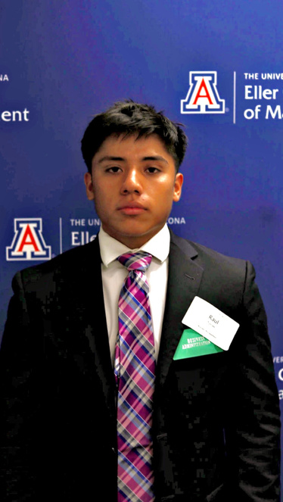
UAHA Scholar Story
UAHA Scholar: Raul Torres Junior, Class of 2026
Molecular & Cellular Biology, Business Management
Being a UAHA Scholar has been one of the most impactful moments in my lifetime so far. For once in my life, I have felt the feeling that others truly believe in me, and cheer on my efforts to strive for a better future. UAHA has given me the backbone to strive for it all in life. The UAHA community is very heart-warming and caring. The UAHA scholarship has allowed me to focus more on my academics and extracurriculars, to strengthen my resume to apply to Medical School someday. The UAHA community has provided a welcoming space, and a place where I feel I belong.
Being a UAHA Scholar has made a significant impact on my experience at the UA. I have met many individuals as a UAHA Scholar who have inspired me to strive for more in life. I have been able to connect with many UAHA Scholar’s, who closely relate to me in many ways. That feeling is one of the best feelings in the world, and provides a strong sense of belonging. Which has allowed me to enhance my academics and personal lifestyles.
I would highly encourage others to apply for this scholarship for many reasons. UAHA provides a sense of belonging that I have not found anywhere else at the UA. It also relieves a financial burden, which allows you to pursue other activities. Which for me was to be involved in activities that will enhance my Medical School application. Instead of having to worry how to pay my tuition throughout the school year. However, the scholarship is the least that has made an impact on my life, since being at the UA. The UAHA community is one of the greatest communities I have been a part of, because of the love and support I have received from it every day.
The UAHA is something I would love to be a part of after graduation. I would love to serve as a mentor and provider for other students that are in the same position I once was. The abundant amount of support and guidance that UAHA has provided me is something that I hope to repay some day. UAHA has made a tremendous impact on not only my life, but my family's life as well, which is something that holds deep to my heart.

Slide 26
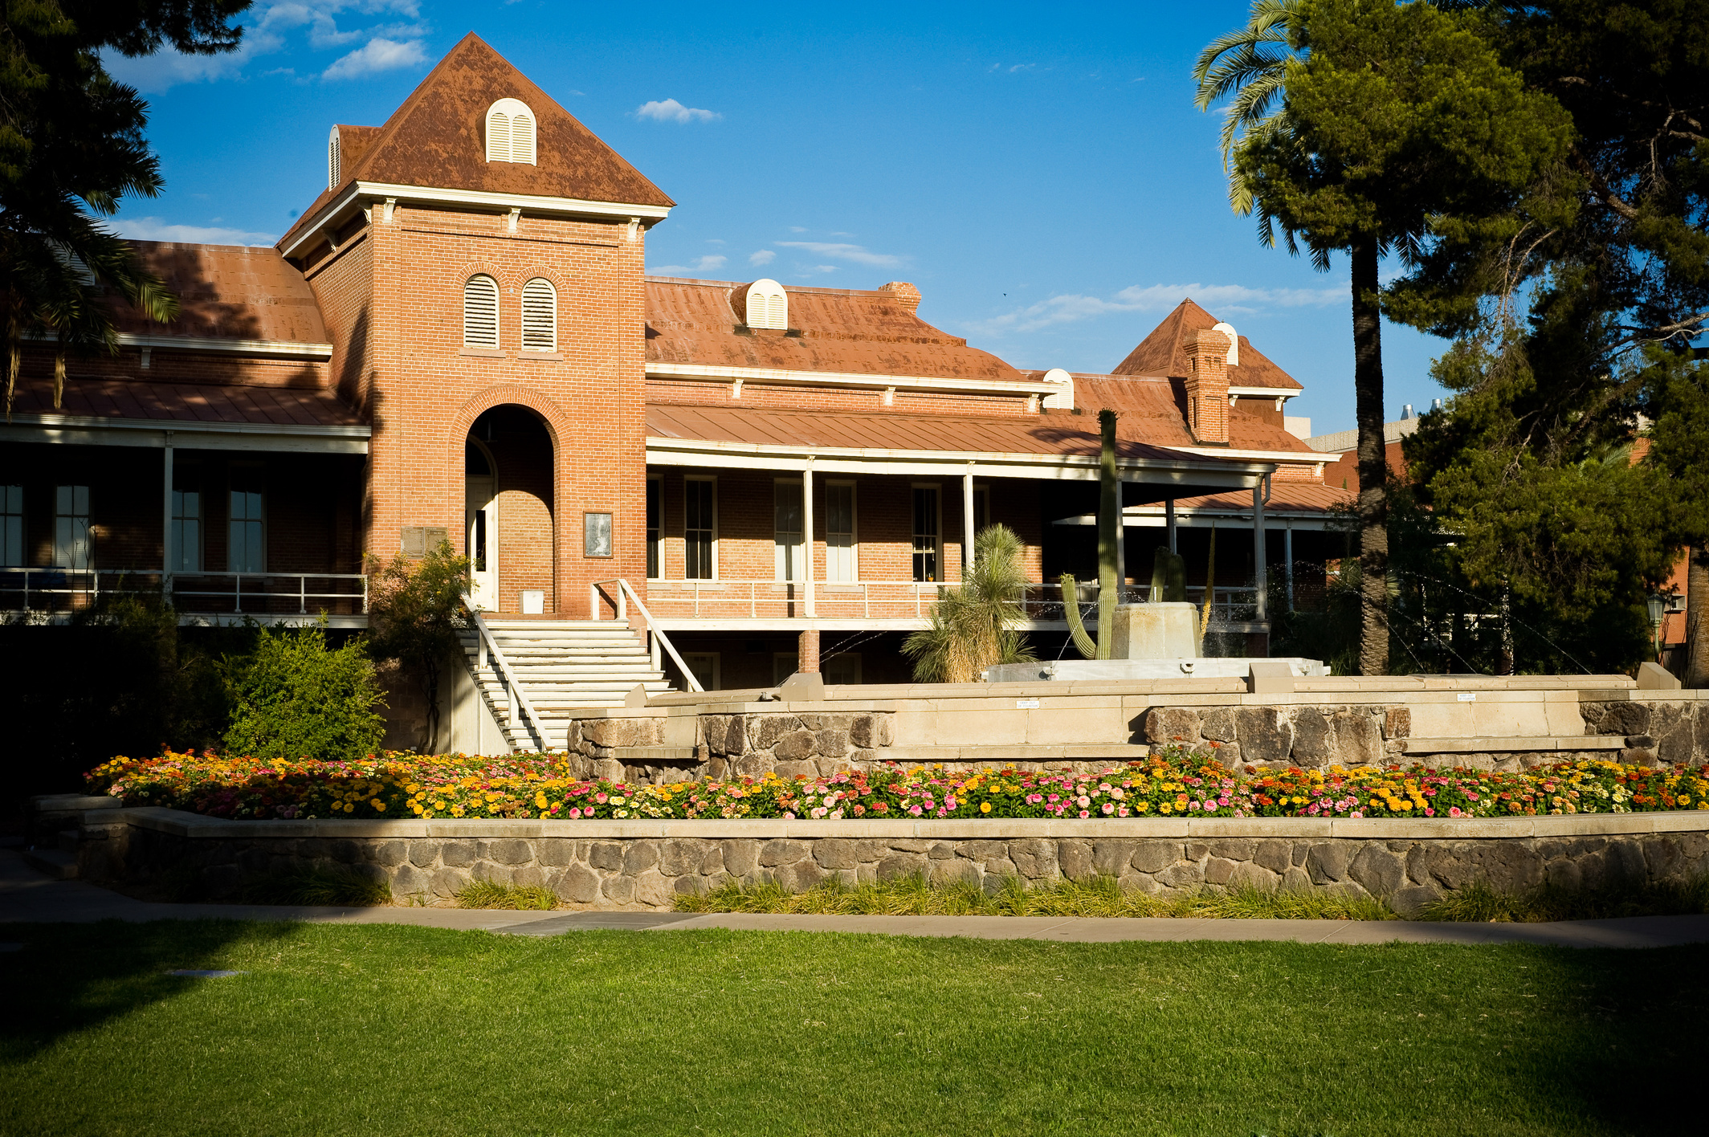

Dear Czarina,
It is with immense pride and heartfelt gratitude that I congratulate you on being recognized at the 2025 Portraits of Excellence, UAHA's yearly fundraiser honoring outstanding members of our community for their significant contributions to students, the Hispanic community, and education.
Your extraordinary dedication and unwavering commitment to advancing cardiovascular health through your philanthropy have been transformative. Your generosity has not only empowered groundbreaking research and enhanced patient care at the Sarver Heart Center but has also inspired hope for countless individuals and families.
Through your leadership and support of the UAHA Endowment Scholarship Fund, you are paving the way for future generations of UAHA scholars at the University of Arizona, creating opportunities and fostering excellence that will impact lives for years to come.
Thank you, Czarina, for being a true champion of these vital causes. It is an honor to witness and celebrate your enduring impact on our community and beyond.
With profound appreciation,
Hesham Sadek, MD, PhD

Slide 27
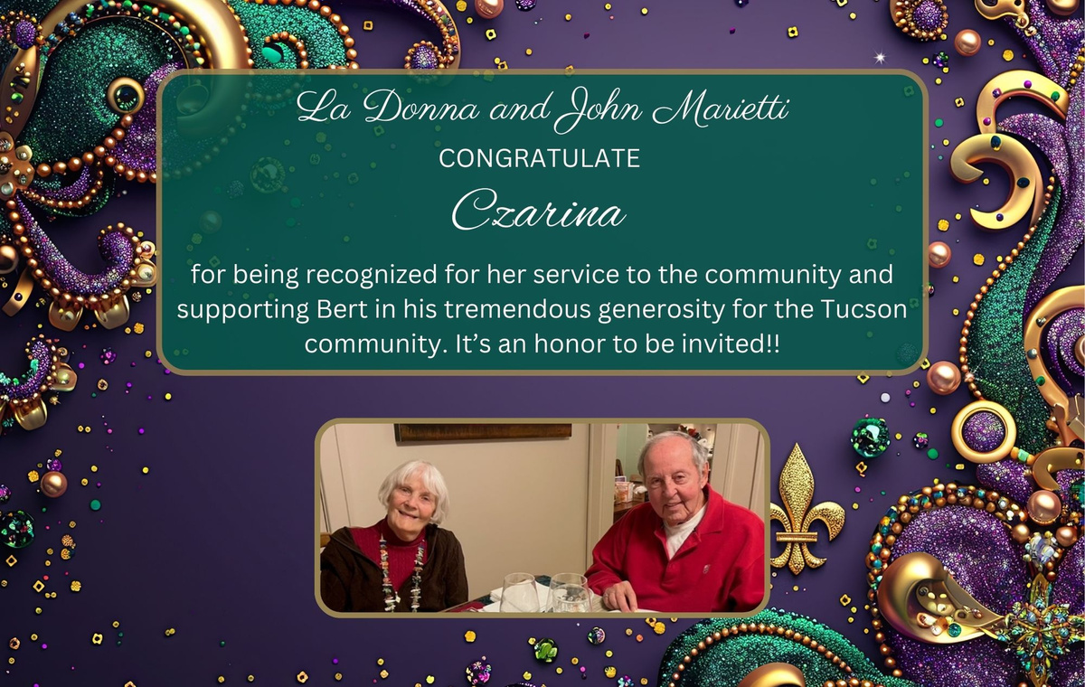
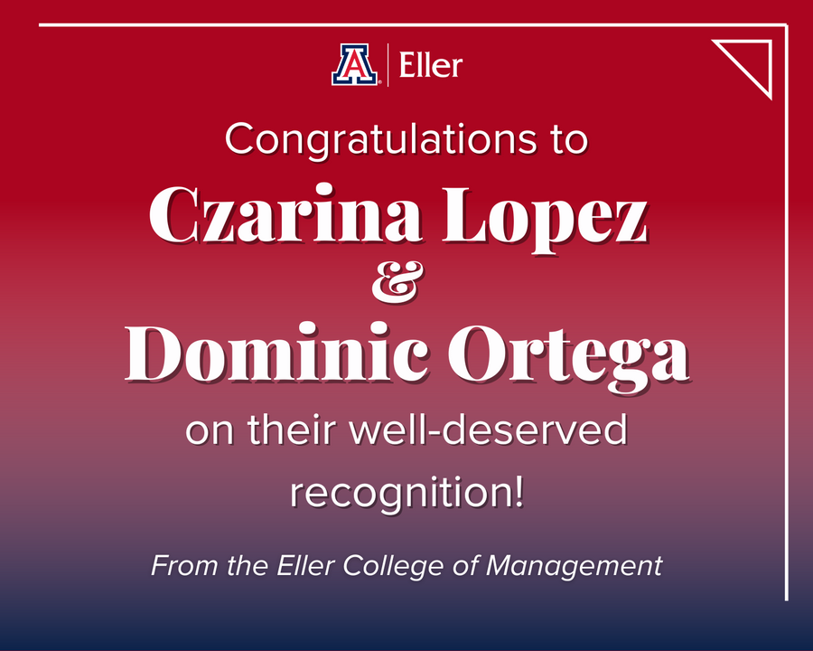

Slide 28

CONGRATULATIONS
to
Dominic and Czarina
The honorees of the UAHA Portraits of Excellence 2025! Your dedication and achievements inspire us all.
-The Lohse Ladies

Slide 29
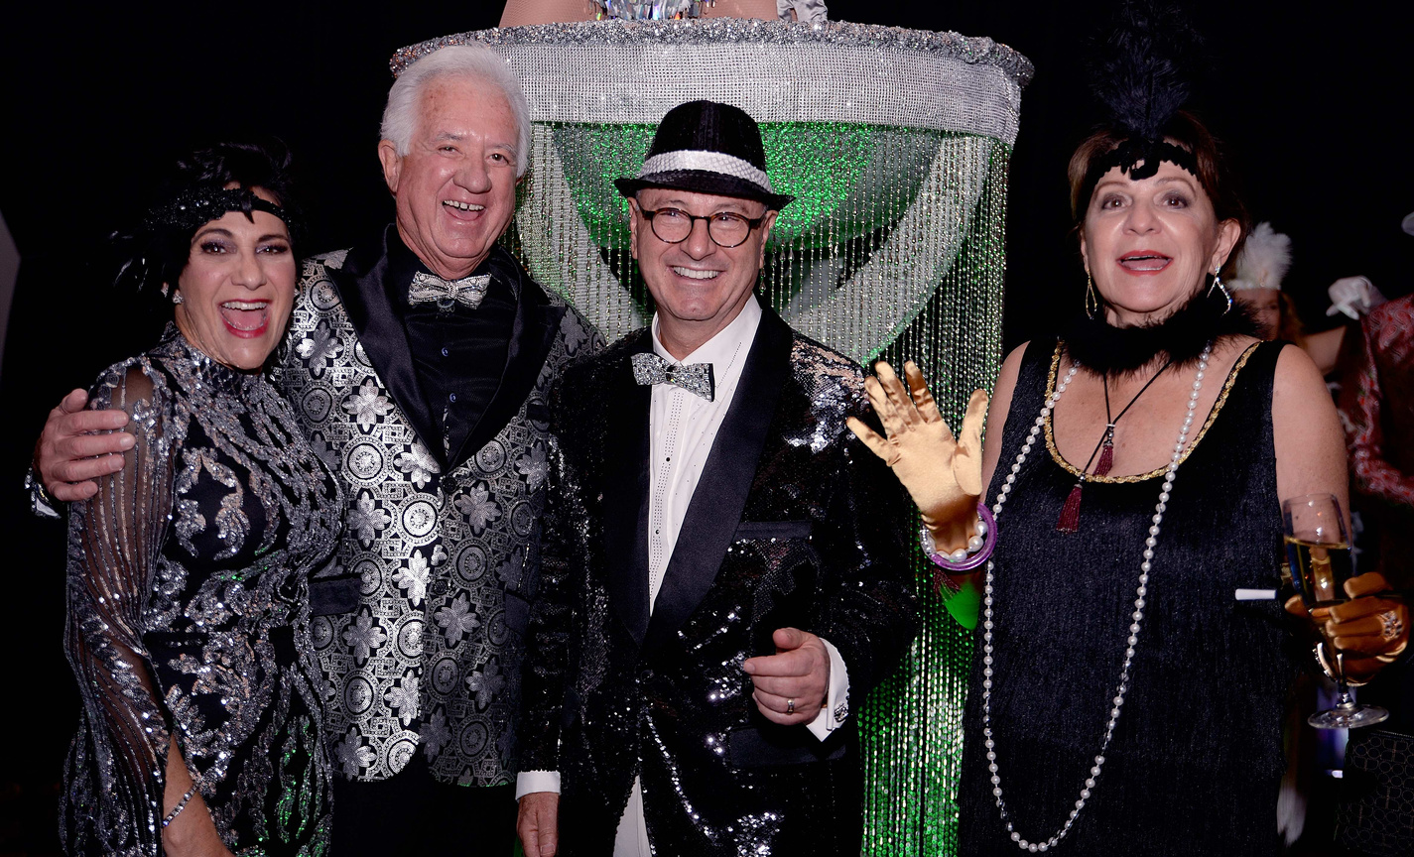
Czarina, behind a great man there is always an even greater woman that works hard towards success. We are so happy for you and your achievements.
CONGRATULATIONS!
Carlos and Esther Michan

Slide 30

Dearest Czarina,
Thank you for being such a compassionate and excellent leader of our community. And being an inspiration to us and many others to do the same.
For many years now, we’ve watched you give of yourself to our community and all those who need you. Your efforts always shine through!
We are so proud of you and cherish our friendship.
Love,
Alice & Paul

Slide 31


SAVE THE DATE
Join us for the 2025
Arizona Football
Hispanic Heritage
Game & Tailgate!
September 13th, 2025
Arizona Stadium
AZ Wildcats vs Kansas St.

Slide 32

Congratulations
and
warmest wishes to
Czarina
&
Dominic
We salute your receipt of this special honor.
Your friends,
Ellen and David Goldstein

Slide 33

Heartiest Congratulations
Dominic
&
Czarina
People like you make the world a better place.
Love,
Reema & Jaggi

Slide 34


Slide 35



Slide 36




Slide 37
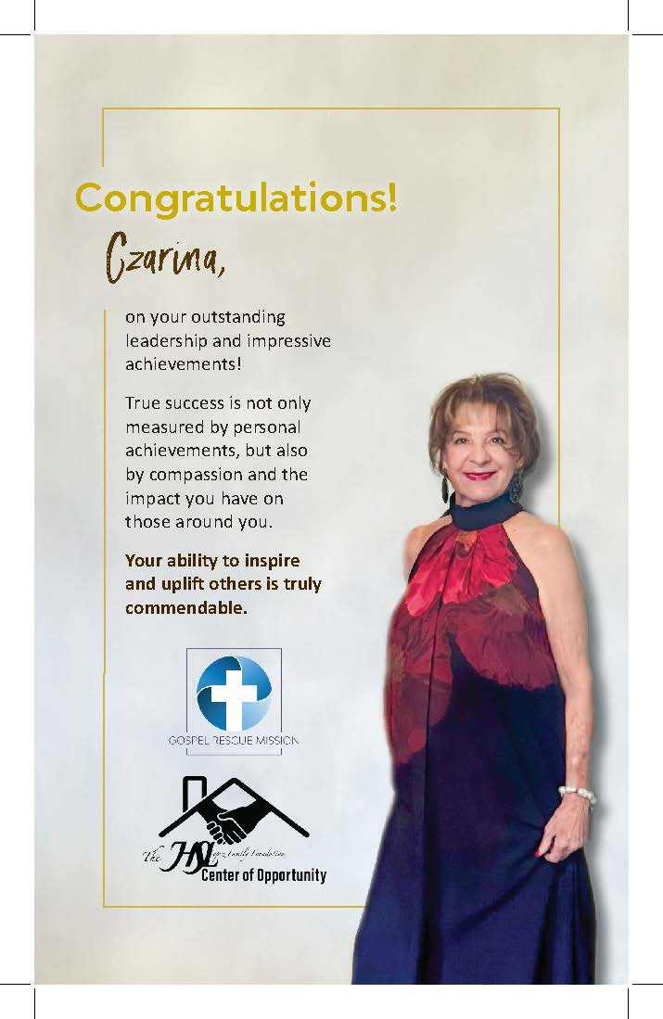

Slide 38
Czarina,
Congratulations on being recognized as a UAHA Portraits of Excellence 2025 honoree! Your dedication, leadership, and contributions have made a lasting impact, and this honor is well deserved.
Best wishes,
James & Mary Horvath

Slide 39
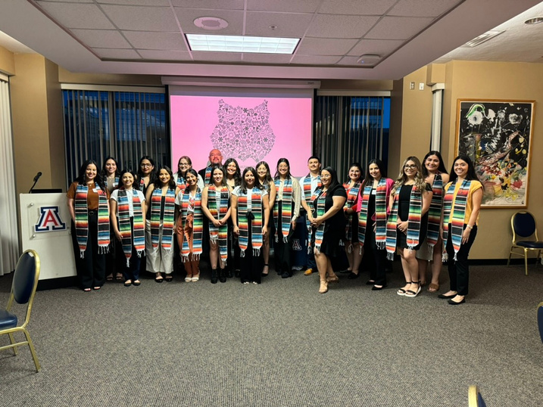
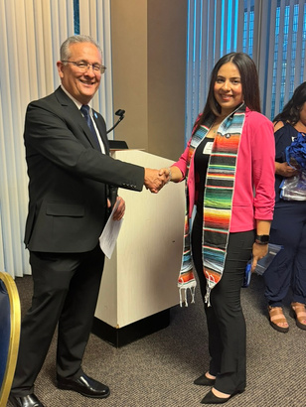
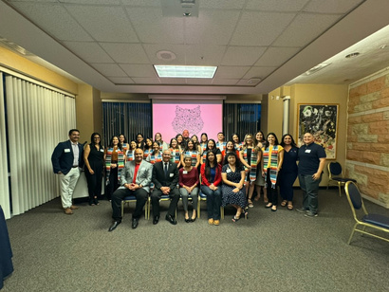
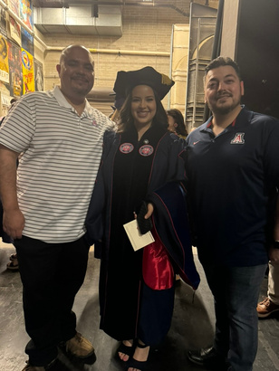
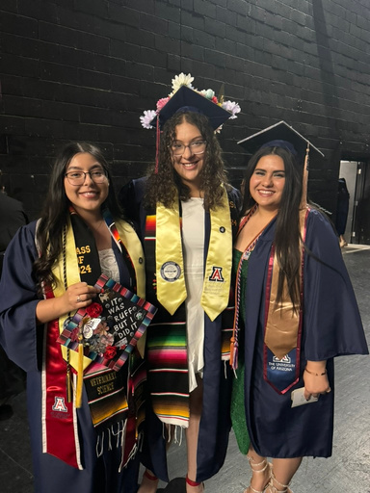
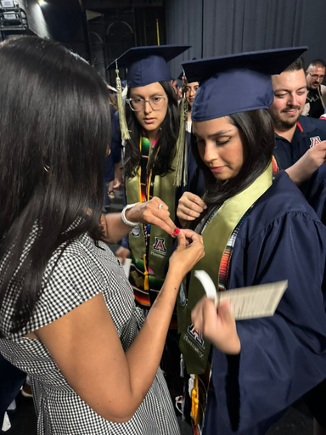
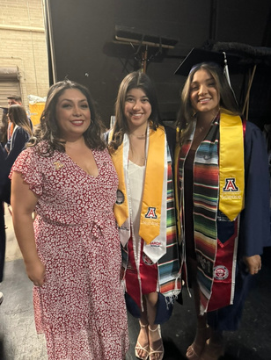
2024 UAHA Highlights
April 17, 2024 - UAHA Scholar Graduate Dinner
UAHA celebrated its graduates of 2023-2024 by hosting a dinner for graduates and guests. UAHA Scholars received a stole to wear for convocations and were pinned with their own
UA Hispanic Alumni pin.
May 13, 2024 - Guerrero Student Center Convocation
UAHA participated in the 2024 Adalberto and Ana Guerrero Student Center Convocation. UAHA members participated in the ceremony, UAHA provided undergraduate and graduate awards, and pinned every graduate with their
UA Hispanic Alumni pin.

Slide 40
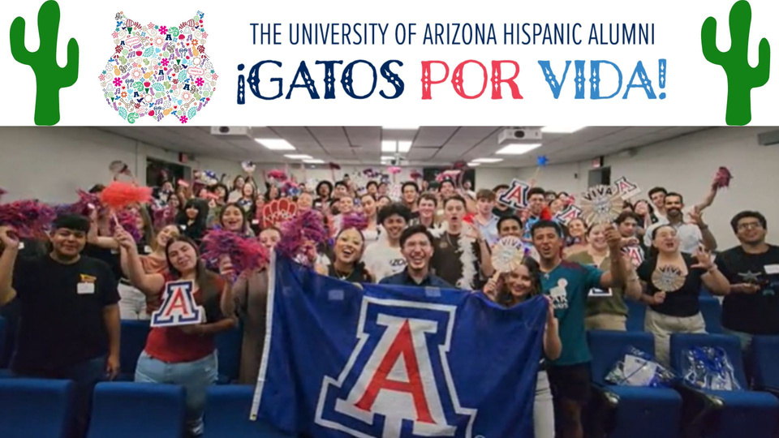
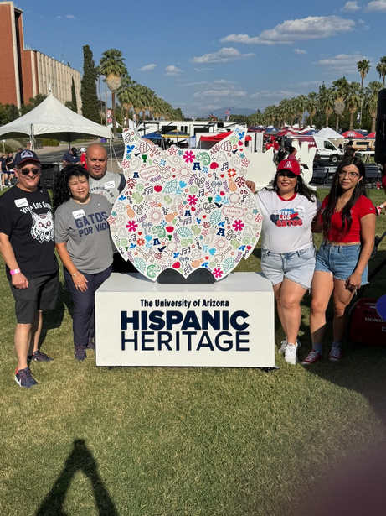
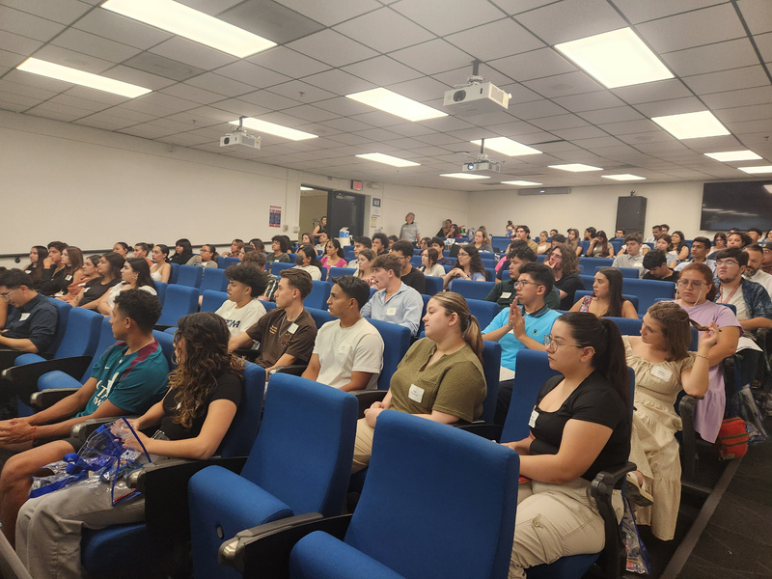
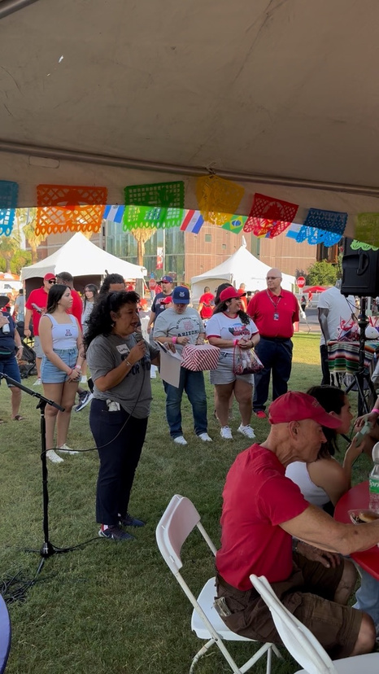
2024 UAHA Highlights
August 29, 2024 - UAHA Scholarship Recipient Kick-off
UAHA hosted a Kick-Off for all 2024-2025 scholars. Students met the UAHA board, fellow scholars, and learned about scholarship requirements.
September 7, 2024 - Hispanic Heritage Game & Tailgate
UAHA partnered with Arizona Athletics, HSI Initiatives, and UA Government & Community Relations to host the annual Hispanic Heritage Game Tailgate on the UA Mall. Tickets included a meal from El Charro catering and free raffle entry for prizes such as UA apparel and signed footballs.

Slide 41
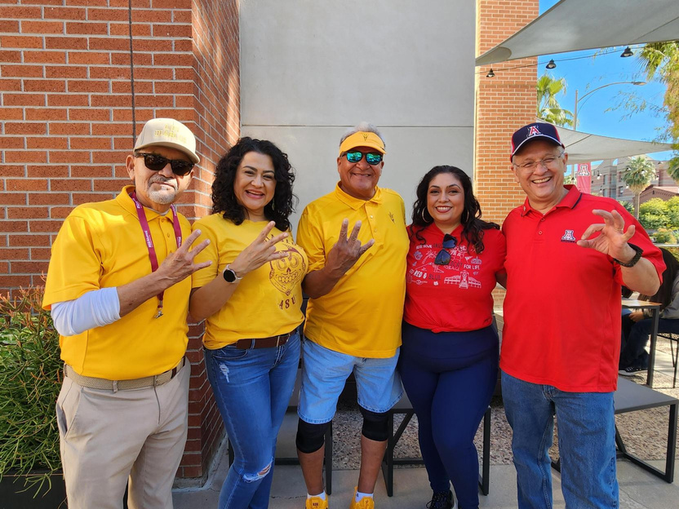
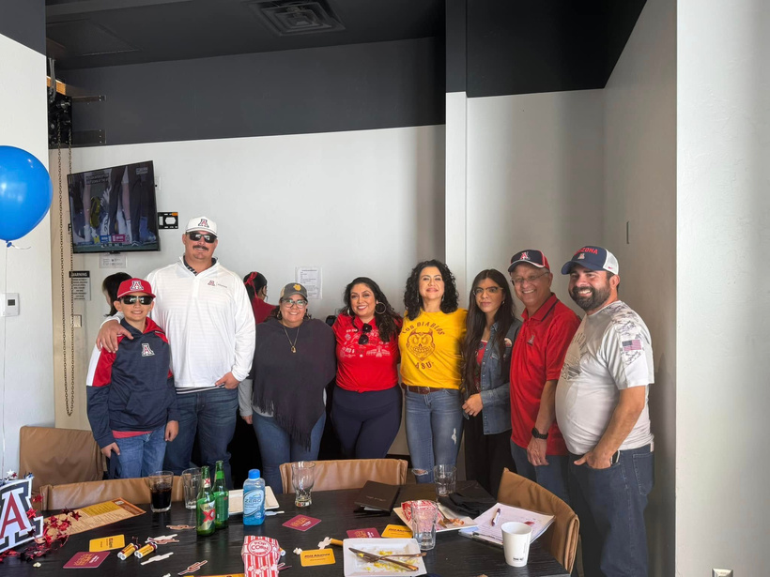
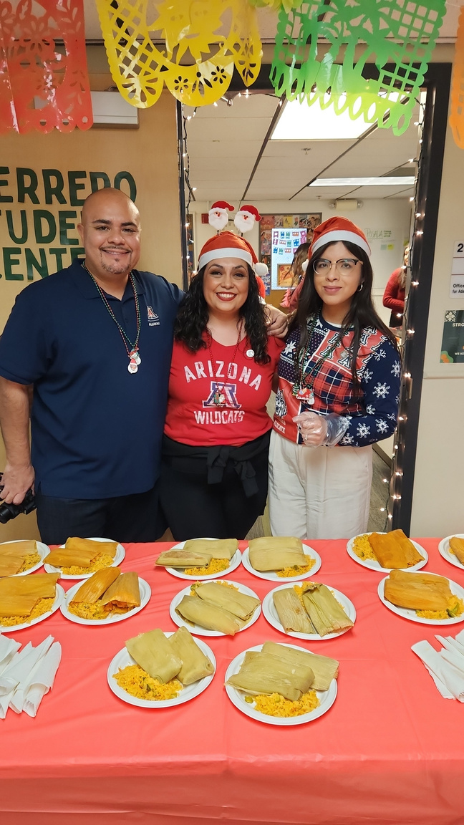
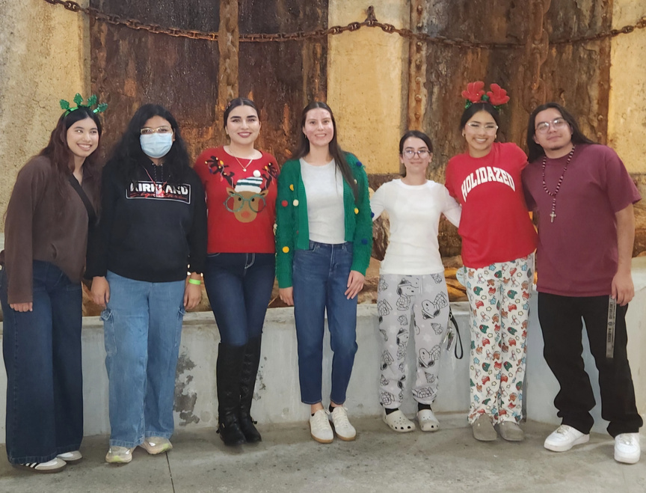
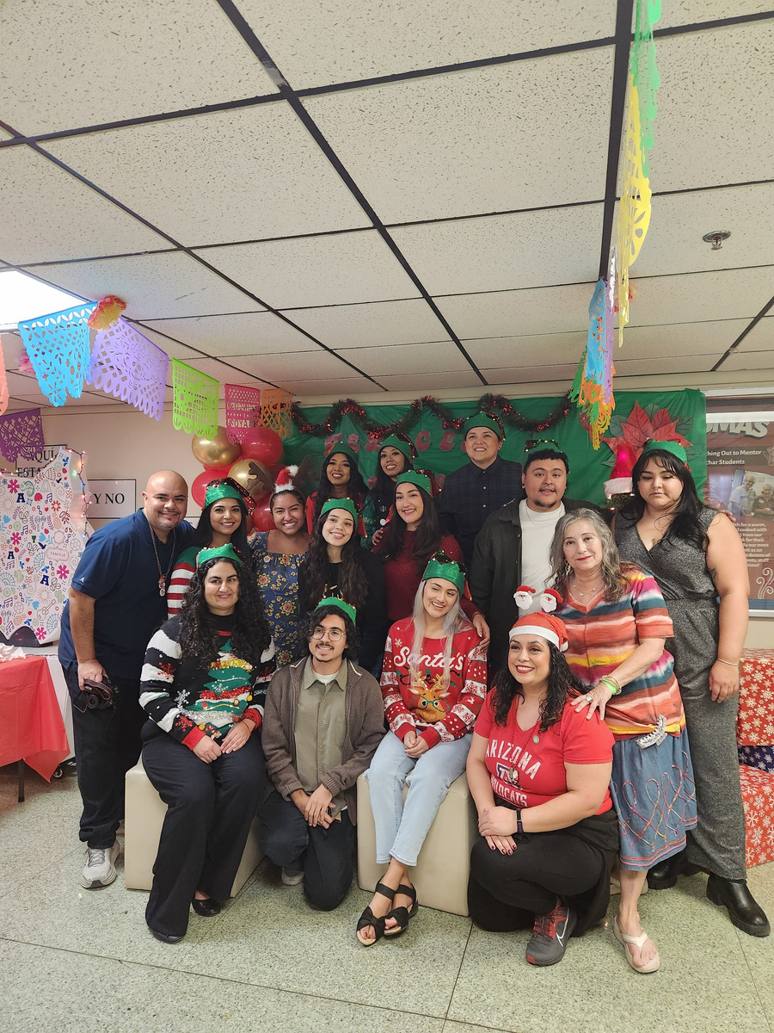
2024 UAHA Highlights
November 30, 2024 - UAHA & Los Diablitos: Territorial Tailgate
UAHA and Los Diablitos from ASU joined together in celebration of camaraderie, cultura, and team spirit. Gatos and Diablos came together to honor tradition, enjoy great food, and share in the excitement of this storied rivalry.
December 6, 2024: Guerrero Student Center Posada
UAHA members joined the Guerrero Student Center for the 3rd Annual GSC Posada, celebrating winter holidays with food, fun, and games. Students were served tamales, played games, and participated in a traditional posada around
the UA campus.

Slide 42
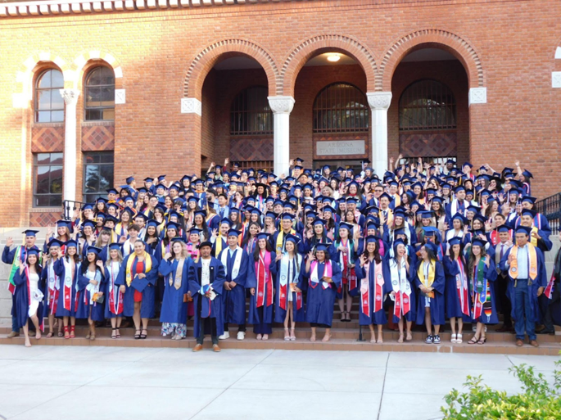



You Can Make a Difference!
Whether through your time, talent, or treasure, you can have a direct impact in the life of a student, today. Join the UAHA community as we come together to further student retention and graduation
- help our UAHA scholars thrive!
How to Give
https://bit.ly/give-UAHA
How to Get Involved
Website: https://uahispanicalumni.arizona.edu/
Email: uazhispanicalumni@gmail.com
Follow UAHA
@ua.hispanic.alumni @uaha1982
2025-2026 UAHA SCHOLARSHIP APPLICATIONS CLOSE ON APRIL 6TH!
VOLUNTEER WITH UAHA! WE NEED APPLICATION READERS!

Slide 43

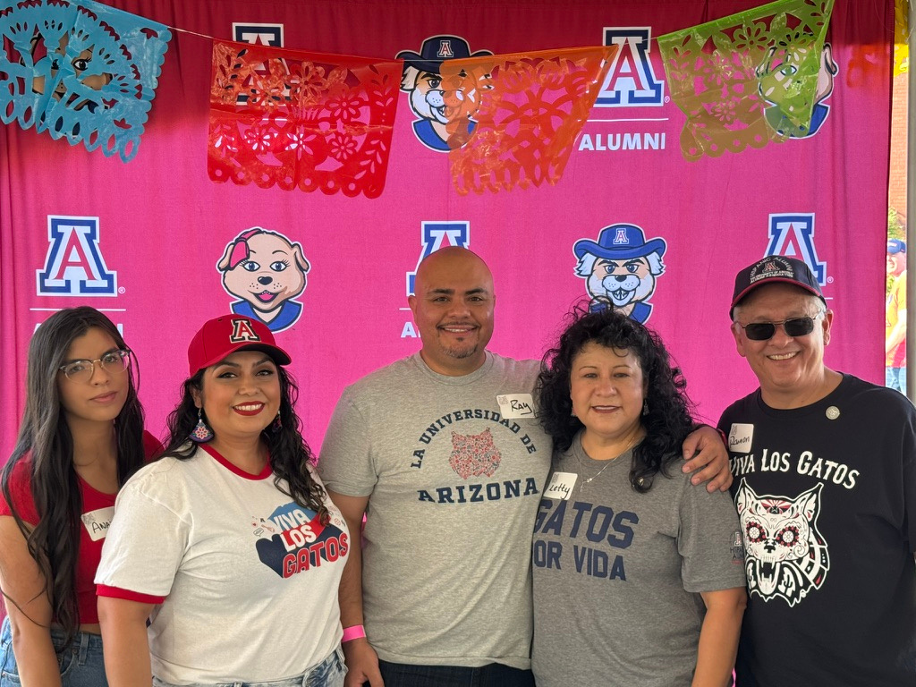
Thank You y Gracias
Thank you for joining us at the
2025 UAHA Portraits of Excellence:
Crowning Excellence!
Tonight, we come together to honor two extraordinary individuals whose dedication, leadership, and wisdom foster a culture of achievement, service, and community.
Your presence tonight reaffirms the legacy and impact of UAHA. All proceeds from this event will support the UAHA Scholarship Endowment, ensuring that we continue empowering students for years to come.
We are deeply grateful for your support and for being part of the UAHA “familia.” Your commitment and enthusiasm make this celebration truly special. Let’s continue to grow this network of excellence and inspire future generations!
2024-2025 UAHA BOARD
President: Letty Molina-Gutierrez
Vice President: Celina Urquidez
Treasurer: Ray Haro
Secretary: Anaid Moreno
Scholarship Co-Chair: Ramon Gutierrez
Scholarship Co-Chair: Anamaria Ramirez Navoa

Slide 44

Thank You to
HSL Properties
Our Portraits of Excellence
VIP Gato Sponsor!

